Slide 1

Unit 4
My things pg.26-27

Slide 2
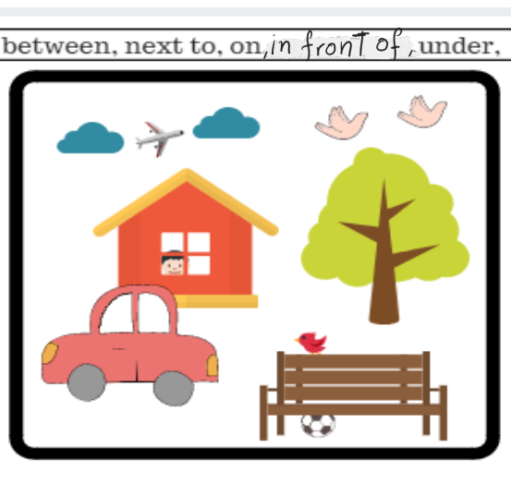
revision
Complete
1-The boy is …in.....the house.
2-The car is …in front of... the house.
3-The ball is ….under.....the bench.
4-The tree is …next to....the house.
5-The airplane is ….between.....the clouds.

Slide 3
overview
Students will spell the words.
Students will be able to count from one to thirty.

Slide 4
Rule
''How many '' Use ‘many’ for things we can count. For example: kittens, sharks, monkeys.

Slide 5
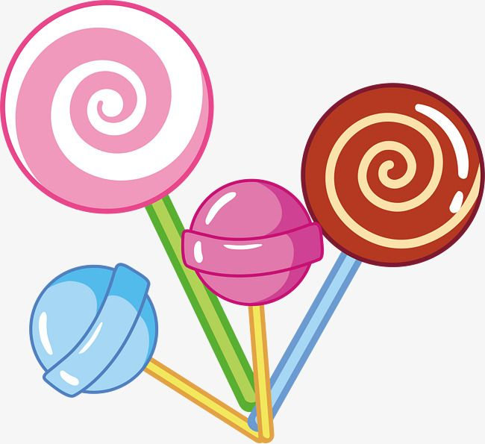
Can I have some candy?

Slide 6
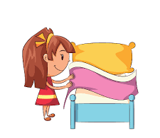
She is making her bed.

Slide 7
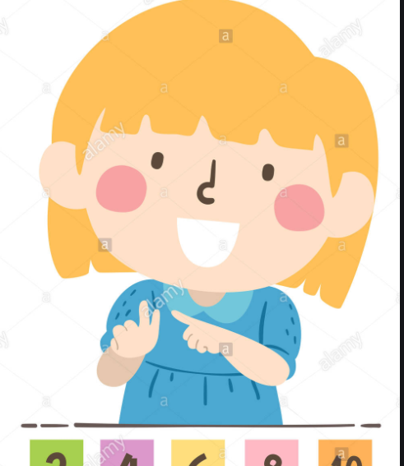
She is count by her fingures.

Slide 8
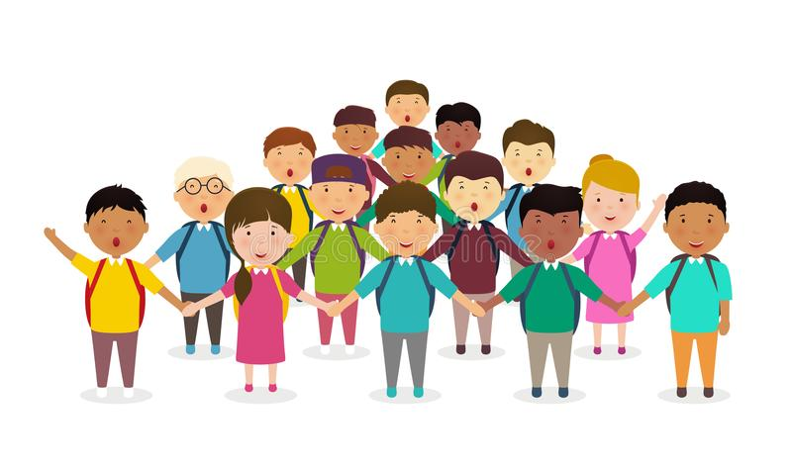
The kids stand row toghther.

Slide 9
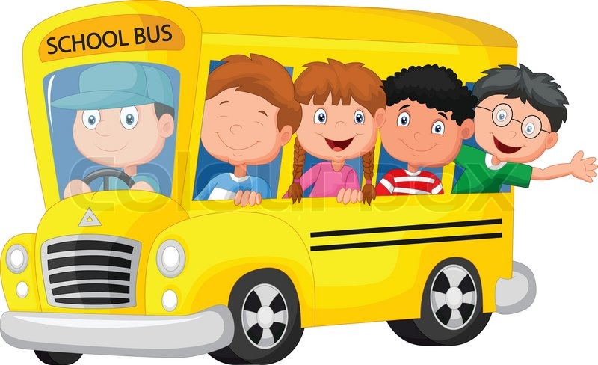
They are in the bus.

Slide 10
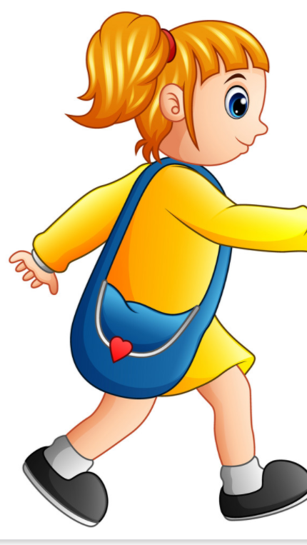
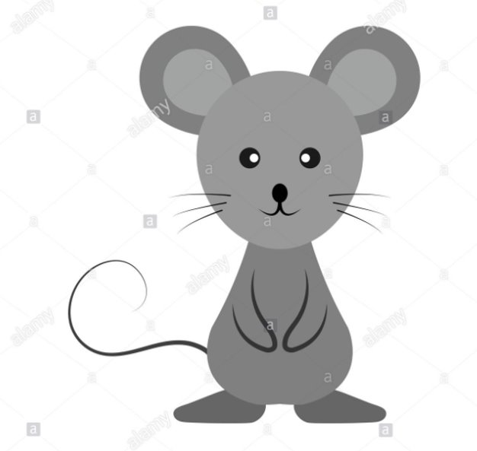

Walk Mouse Eight

